Slide 1
Specifiche Home Page ICS – Paolo Vasta Damiano Gammino (O46002074) A.A. 2020/2021

Slide 2
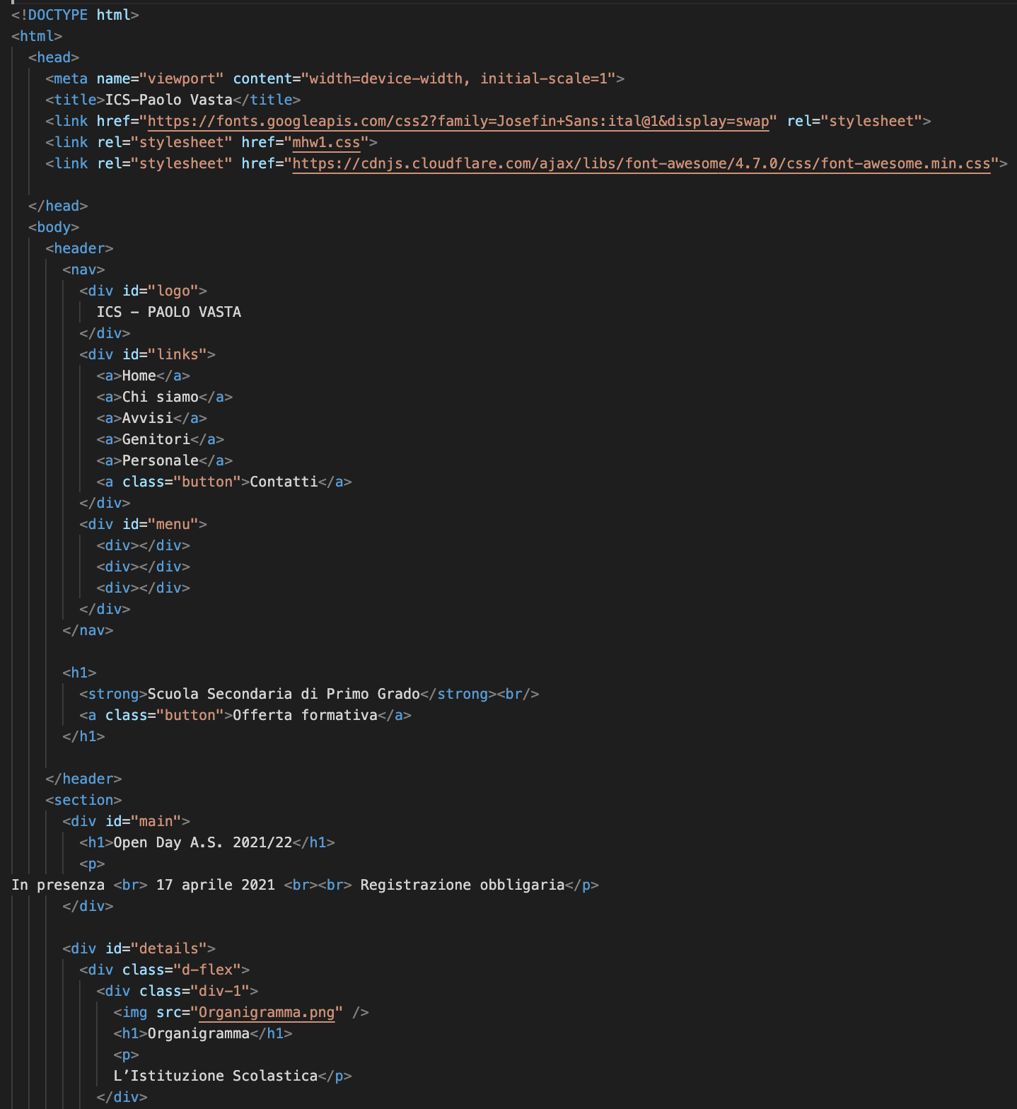
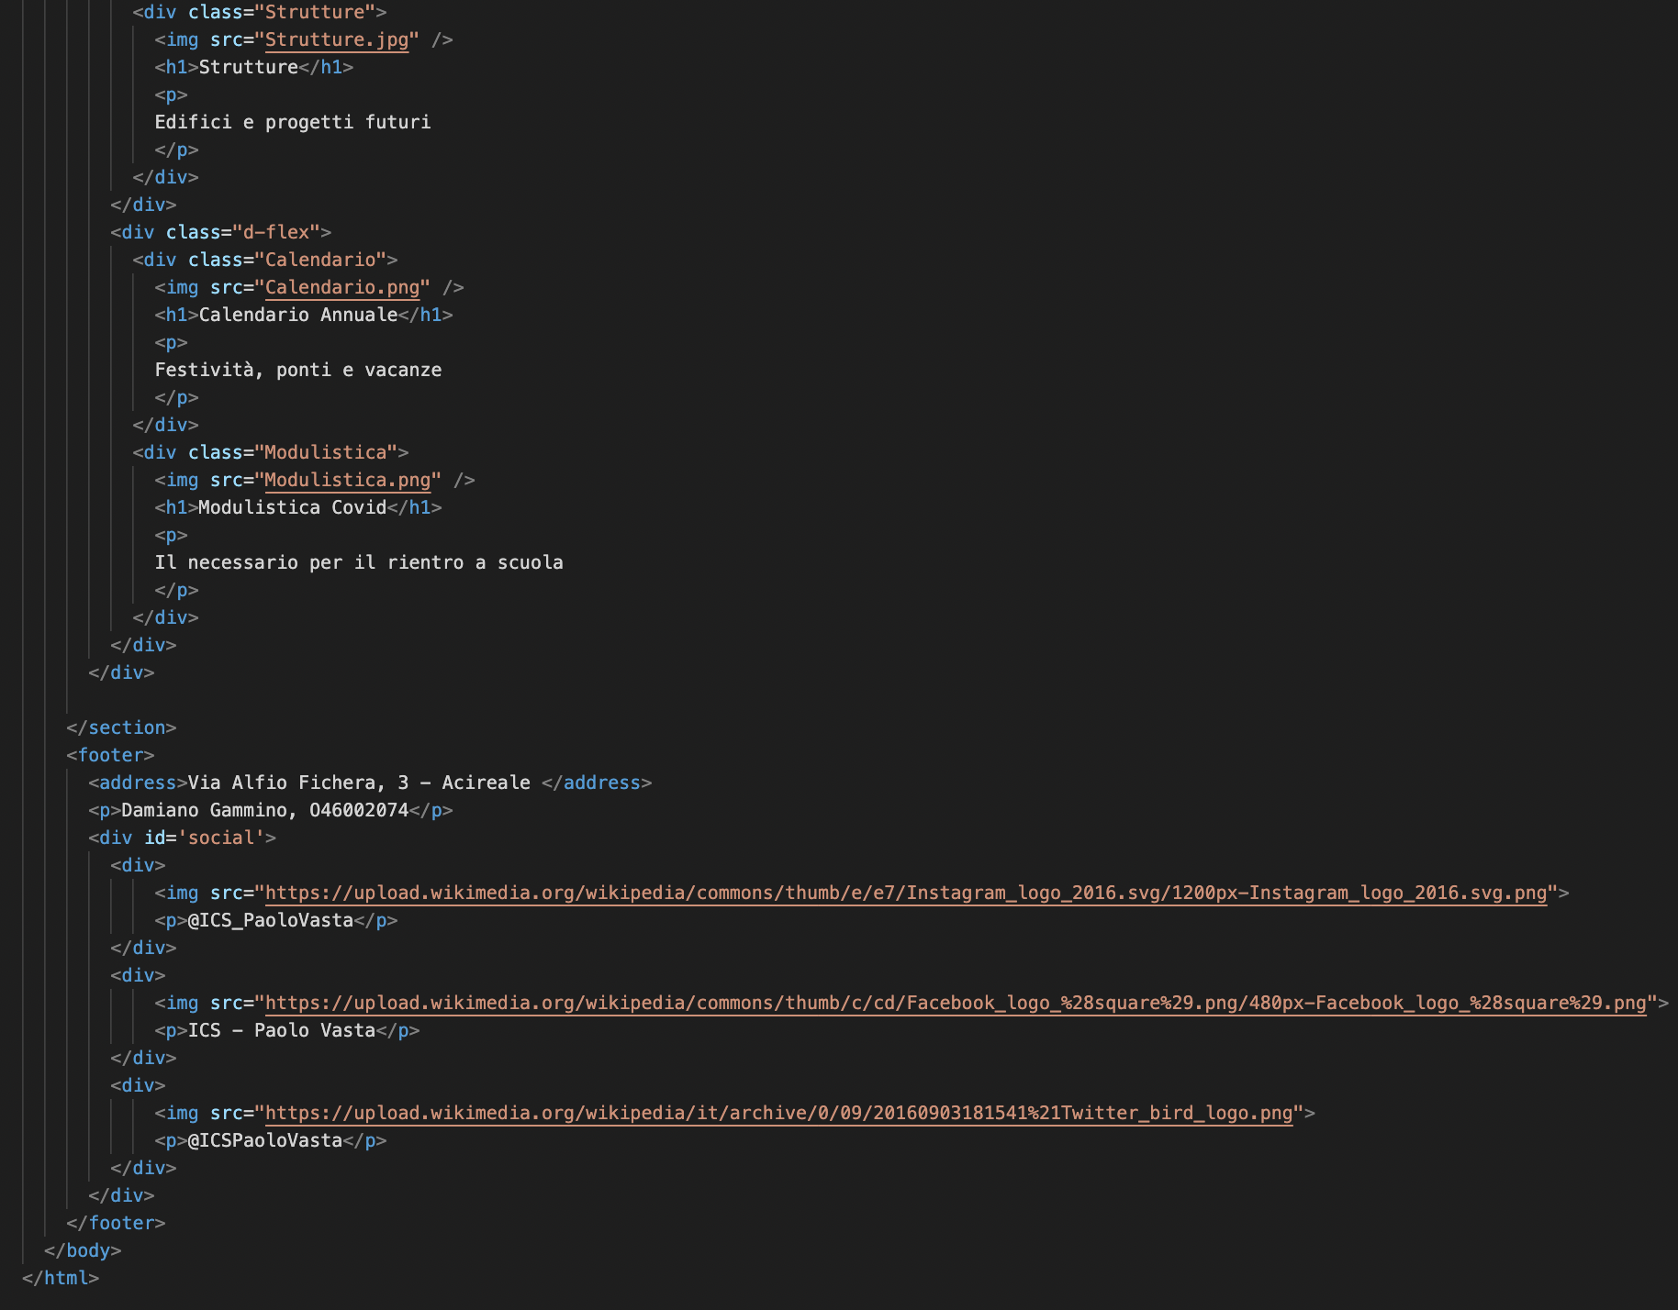
HTML

Slide 3
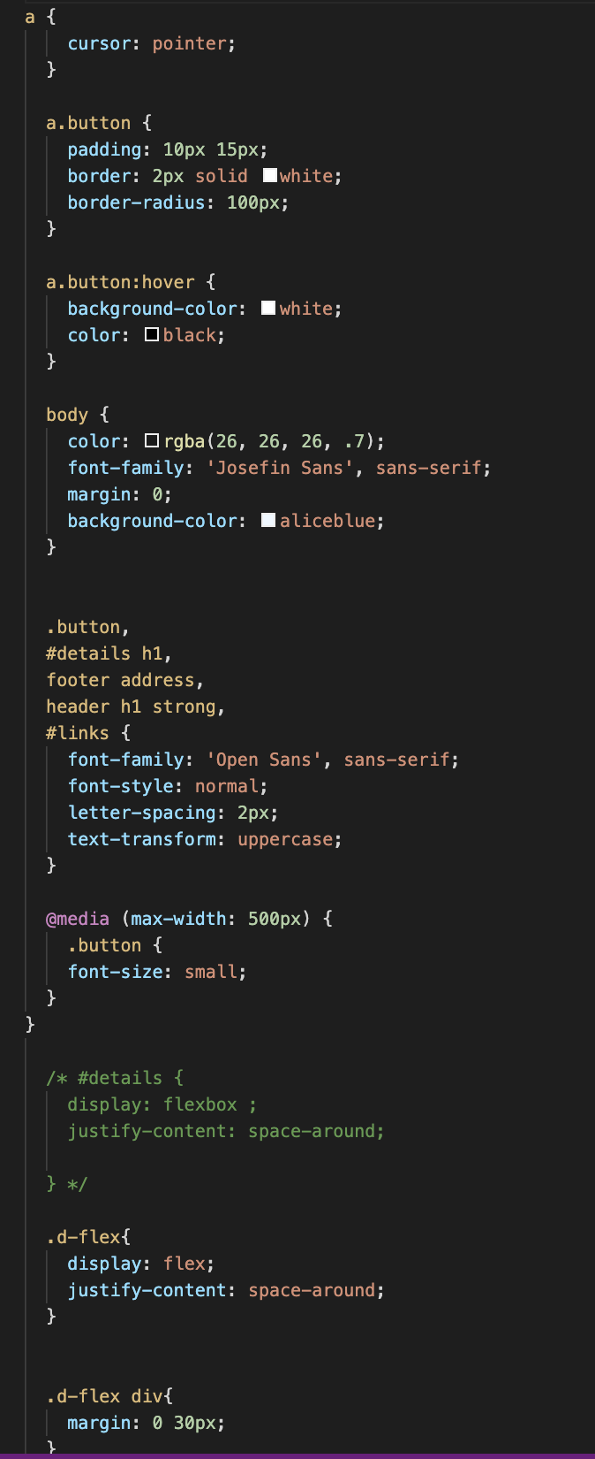
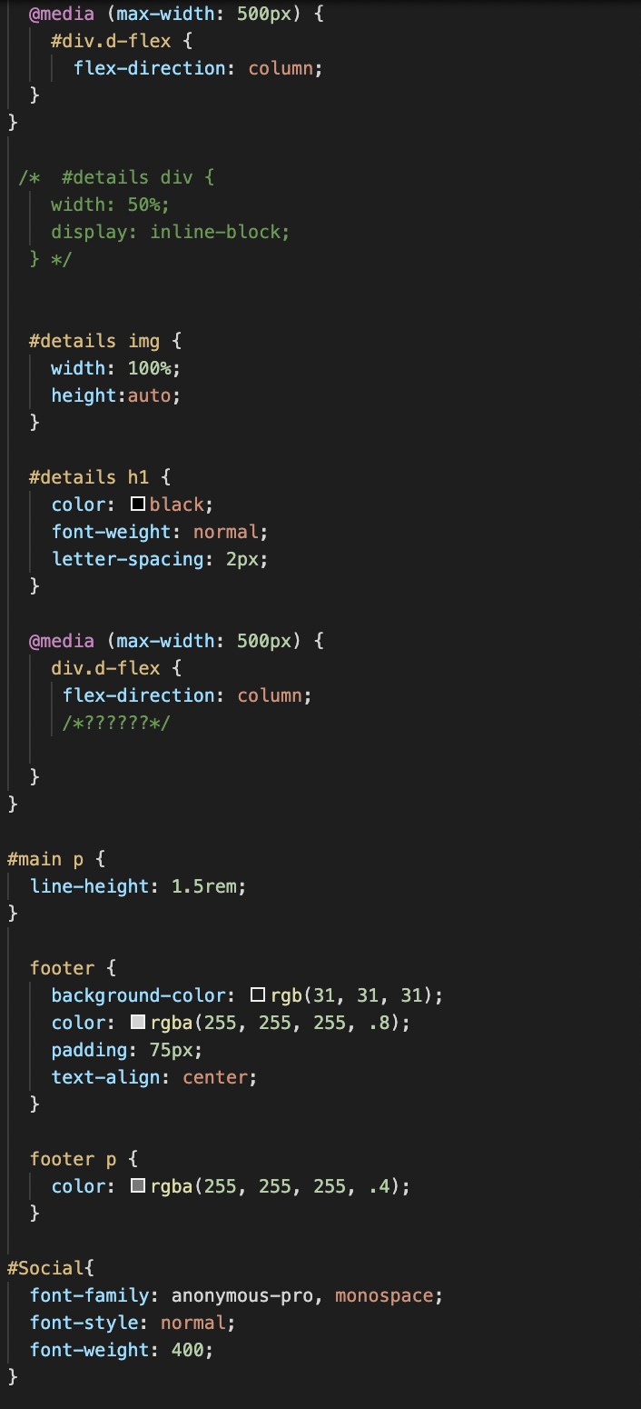
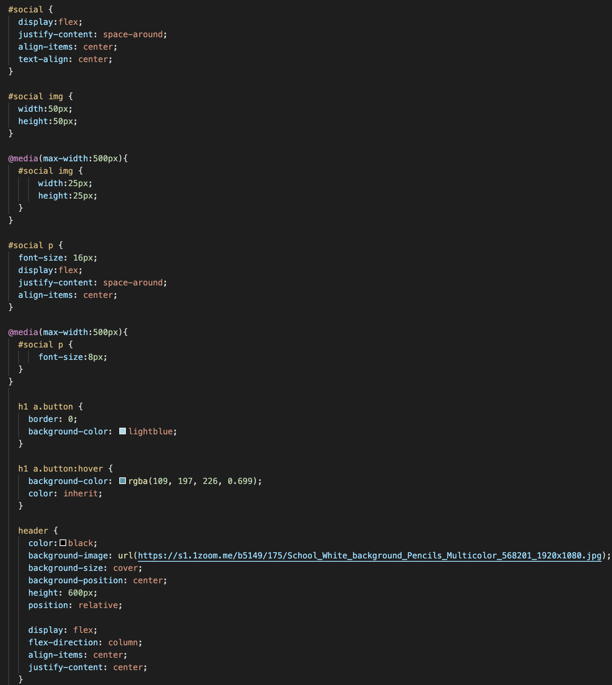
CSS

Slide 4
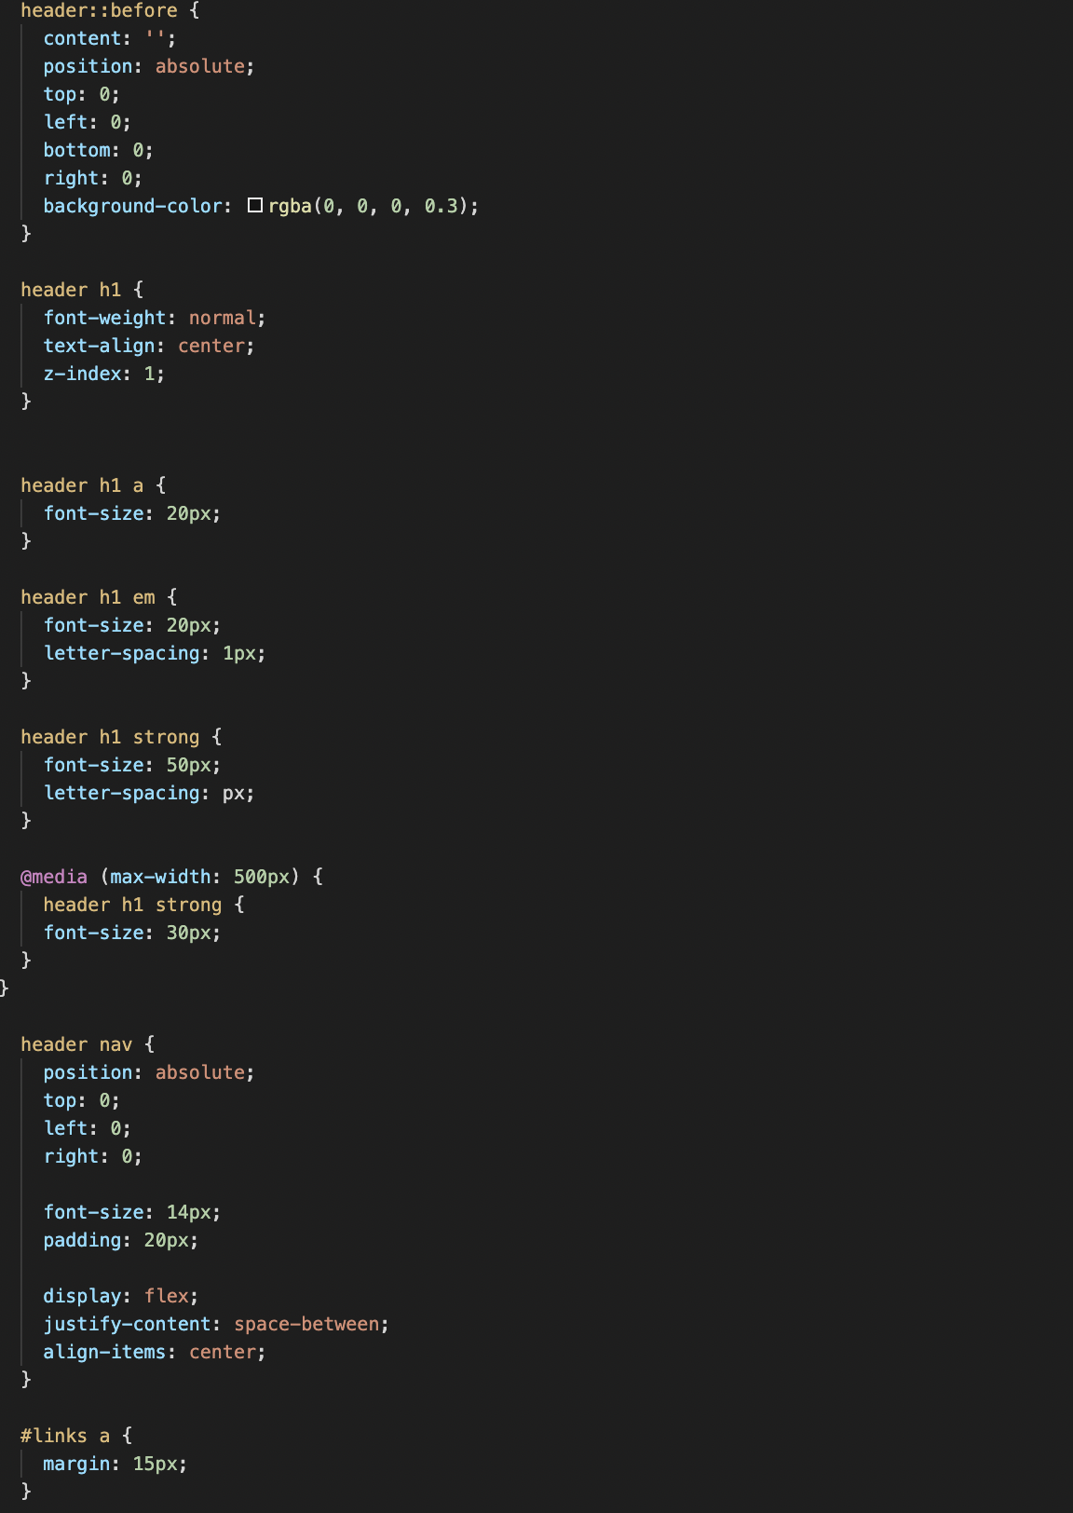
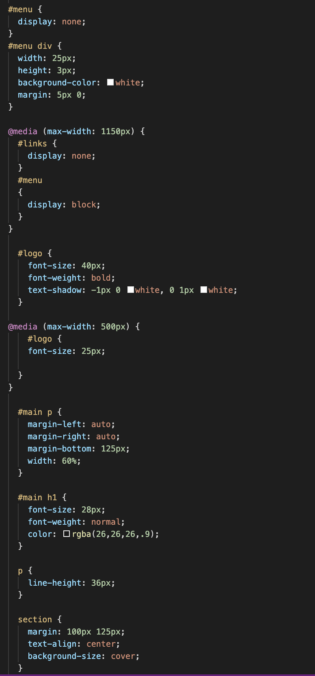
CSS

Slide 5

Header
100% dello schermo
600px

Slide 6

Nav
100% dello schermo
80px
div #logo
div #links
712 px
375 px
40px
16px

Slide 7


h1
1063px
90px
a.button
274px
43px

Slide 8
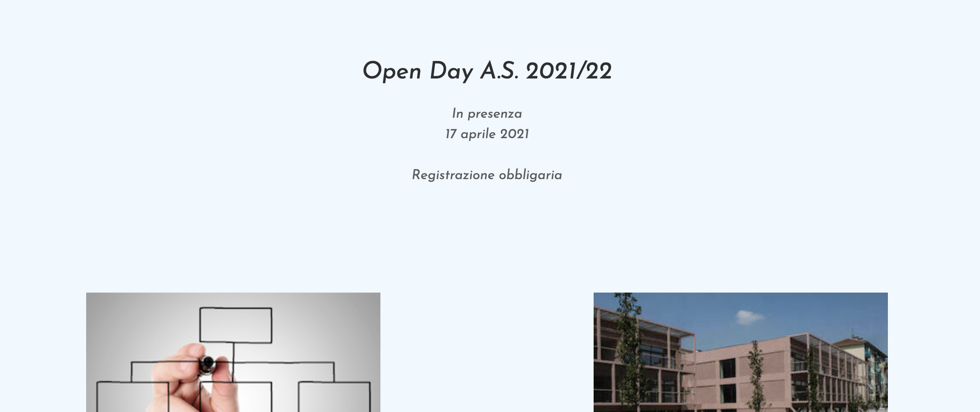
p
714px
96px

Slide 9

div.d-flex
1190px
667px

Slide 10

img
345px
200px

Slide 11

Footer
100% dello schermo
358px

Slide 12


Address
1290px
18px
122px
50px
1290px
Social
img
50px

